Slide 1

Programming 1 Week 2
Part A: Procedures
Part B: Functions
Lewis Evans
Alex Brooke

Slide 2




Outline
Part A
Procedures
Break
Part B
Functions

Slide 3
Procedures
Part A – Procedures
Break
Part B – Functions

Slide 4
Procedures
A Procedure is a named block of code that performs a specific task
We have been using procedures since last week (built-in Processing procedures – ellipse, point, line)
Procedures allow us to ‘package’ together a group of commands to perform a specific task
Avoids repetition
Code is easier to read/understand
Promotes code re-use
Part A – Procedures
Break
Part B – Functions

Slide 5

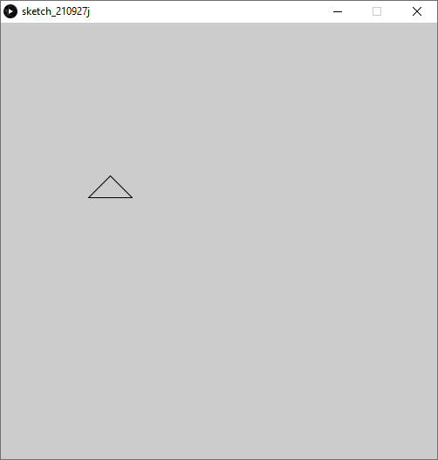
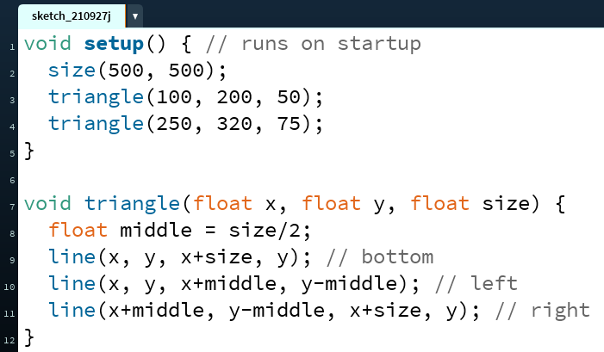
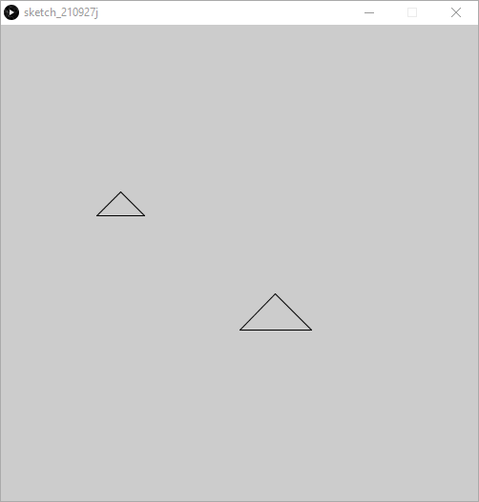
Procedure Example: Triangle
50.0
200.0
75.0
250.0
320.0
x
100.0
y
size
37.5
middle
25.0
Part A – Procedures
Break
Part B – Functions

Slide 6
Let’s get started!
Open up Lab 2.1 (Procedures) and Processing
Part A – Procedures
Break
Part B – Functions

Slide 7
Functions
Like Procedures, but return a value
Part A – Procedures
Break
Part B – Functions

Slide 8
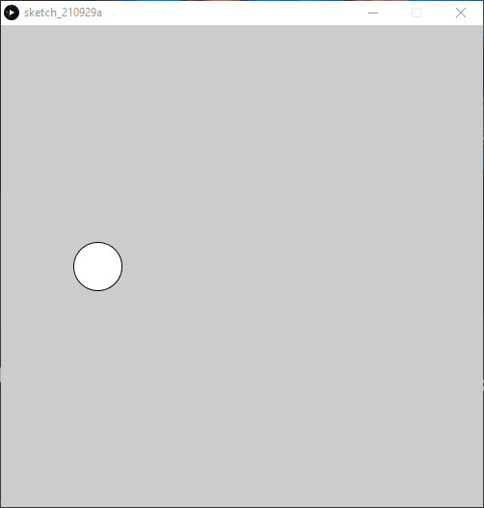

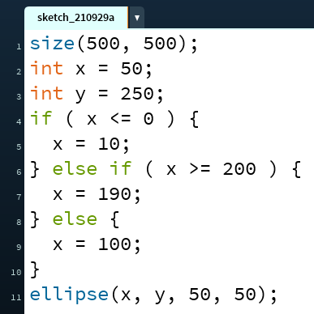
Conditionals
if (test_expression is true) {
do these commands
} else if (2nd_test expression is true) {
do these commands instead
} else {
do these other commands instead
}
100
x
50
y
250
Part A – Procedures
Break
Part B – Functions

Slide 9
Functions
We know that a Procedure is a named block of code that is used to package together a series of commands (e.g. motorbike procedure – 2 wheels and 1 triangle)
A function is exactly the same – except when it’s finished performing its task, it returns a value to us
What exactly does that mean?
Part A – Procedures
Break
Part B – Functions

Slide 10
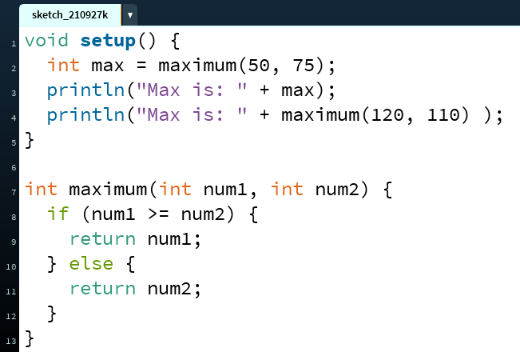

Function Example
Console Output
max
110
120
75
num1
50
num2
120
75
Part A – Procedures
Break
Part B – Functions

Slide 11

Procedures vs Functions
Procedures
Block of code that performs a task (e.g. drawing a motorcycle)
Code runs when ‘called’
Use to ‘package’ a commonly used sequence of instructions together
Functions
Functions work in the same way as procedures, but also return some information back to us when they’ve finished performing their task
Part A – Procedures
Break
Part B – Functions

